Slide 1
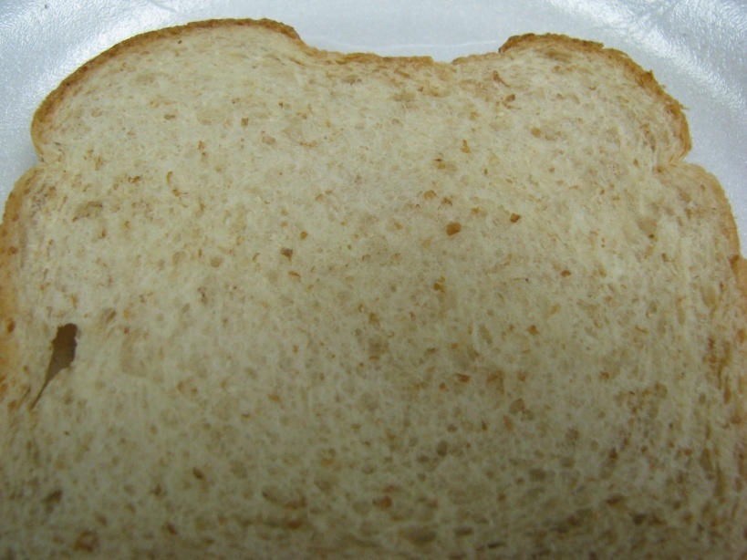
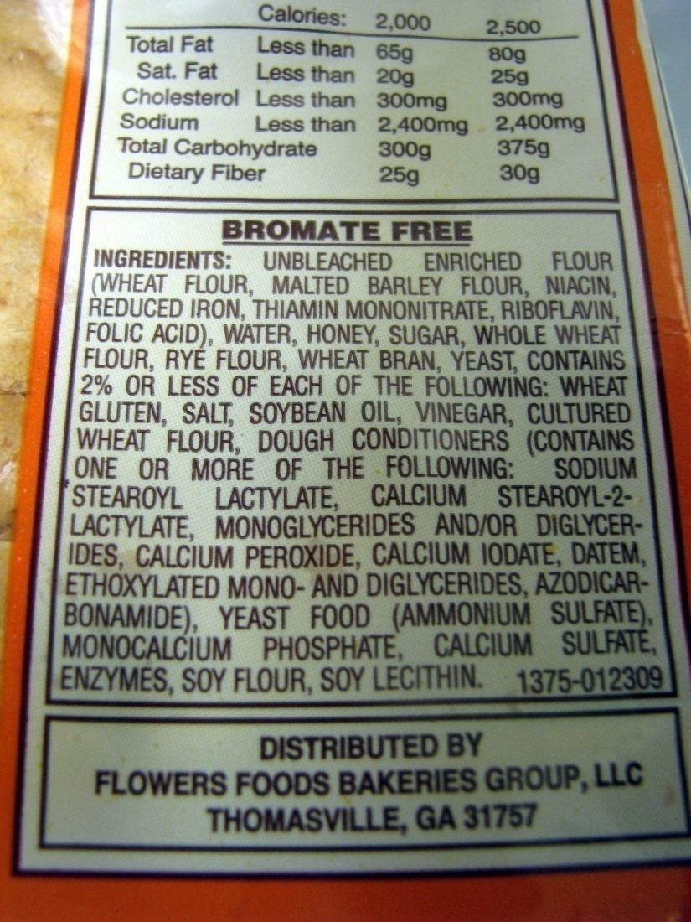
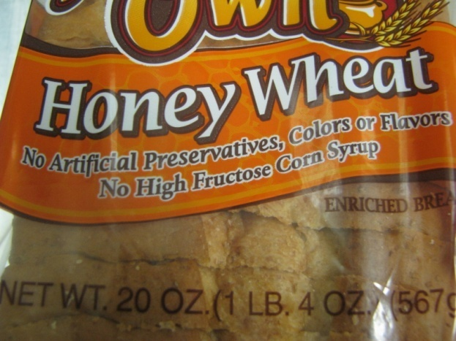
Product “B”- Partial Blend

Slide 2
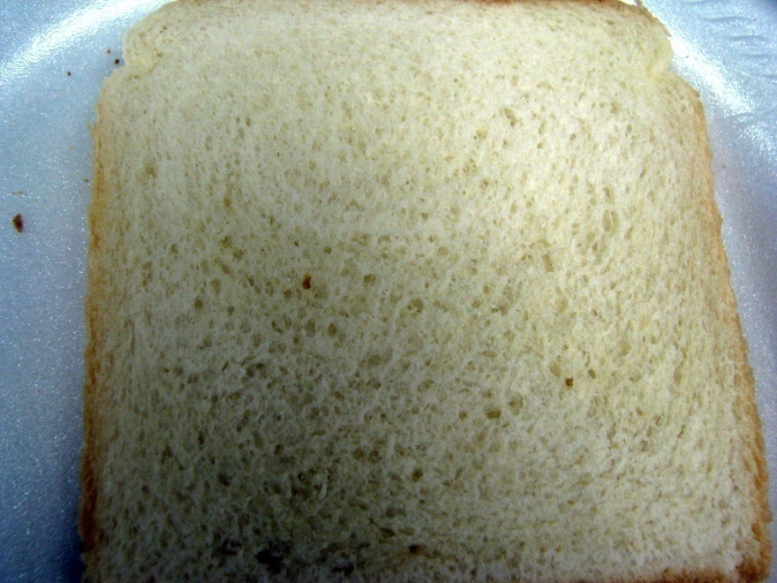

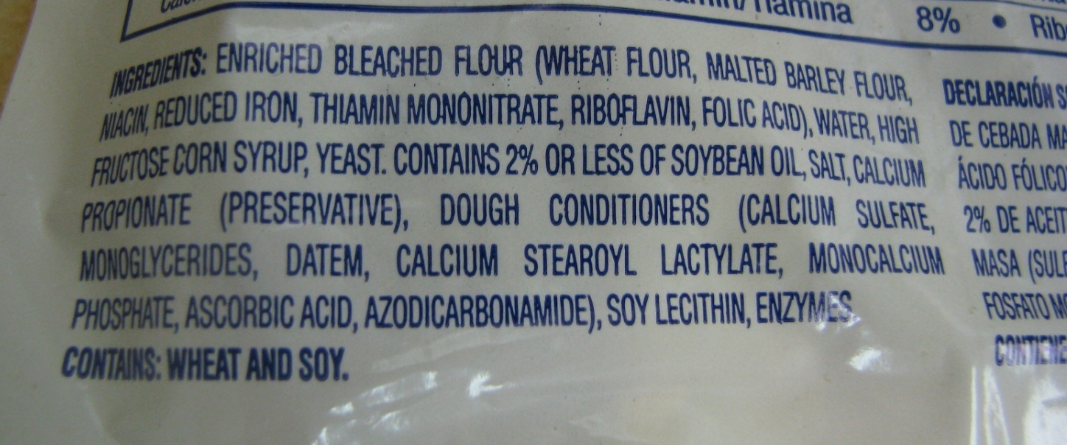
Product “C”- Refined

Slide 3
Fat
Fat doesn’t have a ‘bliss point’ like sugar does. There is almost no limit to how much fat you’ll want in a food
Fat is often invisible. It comes in oils and solids. Saturated fat is a solid fat
Cheese as an example of a fat additive to food that has contributed significantly to the obesity crisis.
Cheese has ‘mouthfeel’

Slide 4
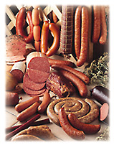
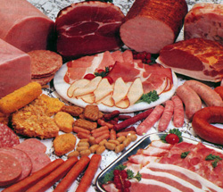
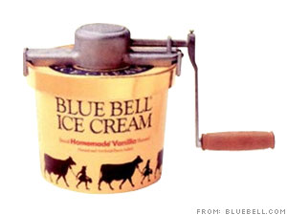

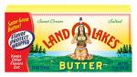

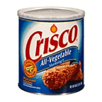
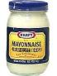

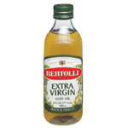


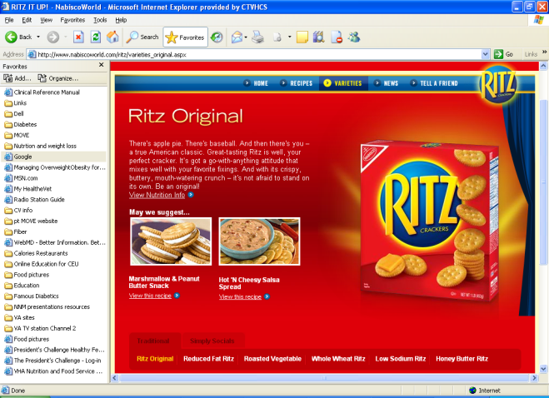
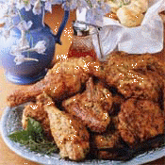
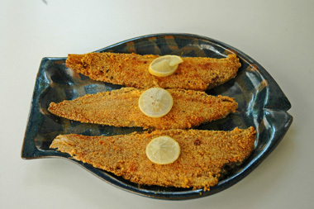
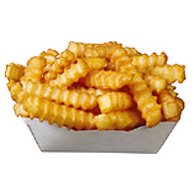
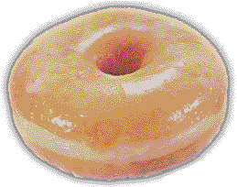
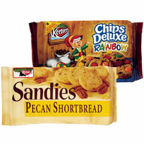

What foods are high in fat?
Animal Foods
Shortenings, oils, margarine, nuts
Fried foods, snack foods and candy

Slide 5
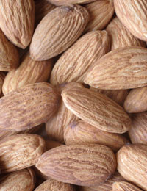
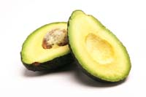
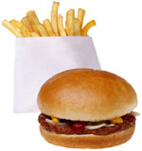
Types of Fat
“Good Fats”
Monounsaturated
Polyunsaturated
“Bad Fats”
Saturated
Hydrogenated
(trans fats)

Slide 6

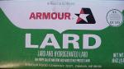
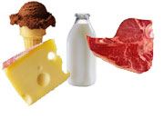
Saturated Fat
Animal Fat
Fatty meats, Whole Milk &
Milk Products, Butter
Lard
Coconut Oil
Palm Oil

Slide 7

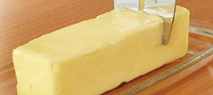
Trans Fat
(Hydrogenated Fat)
Shortening
Stick margarine
In most snacks and store bought desserts

Slide 8
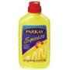
Polyunsaturated Fat
Vegetable Oils
(Corn Oil, Soybean, Safflower, Sunflower)
Mayonnaise
Salad Dressings
Soft Margarines

Slide 9
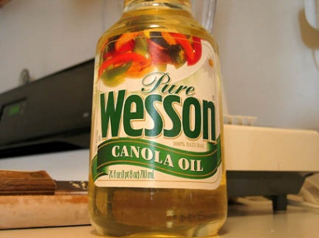
Monounsaturated Fat
Olive Oil, Canola Oil, Peanut Oil
Avocados, Olives
Nuts: walnuts, pecans, almonds

Slide 10
Meat, Poultry, Fish
Fish (contains omega-3 fatty acids which may reduce the risk of heart attack) - Cold water fish is best – Salmon, albacore tuna, sardines.
Poultry - white meat is the lowest in fat (chicken, turkey).
Wild game - venison, rabbit, squirrel.
Lean red meat - pork, beef, veal, lamb (round, sirloin, tenderloin).

Slide 11
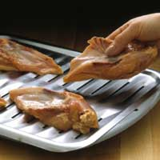
Percent (%) Lean in meats (first number is the % lean; second number is the % fat of the product)
Ground beef:
70/30 = fatty meat
80/20 = better
90/10 = low fat
96/4 = very lean
Ground turkey = 97/3 available
Skinless chicken = 98/2
The seven leanest cuts for “red meat” are: eye round, top round, round tip, top sirloin, bottom round, top loin, and tenderloin.

Slide 12
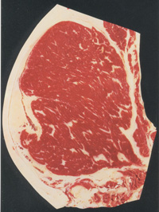
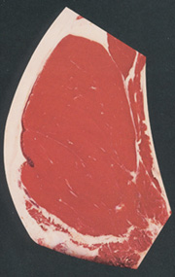
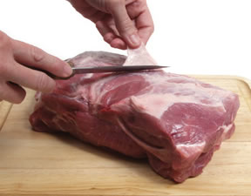
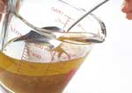
Good Choices in Preparation
Choose leaner cuts of meat
Trim any visible fat
Remove skin from poultry
Skim fat from the top of soups, stews and others foods.
Grill, bake, broil, steam rather than breading and deep frying foods.
Limit gravies
More Marbled
More Fat
Less Marbled
More Lean

Slide 13
Processed Meats
Limit these due to HIGH fat and sodium content.
Choose 97% fat free versions for occasional use.
Bacon Bologna
Sausages Salami
Hot Dogs Most cold cuts
Hot links Most canned chili & stew

Slide 14

Eggs and Milk
Milk
Whole 4.5% fat
Reduced fat 2.0% fat
Low fat 1.0% fat
Nonfat (skim) 0 fat
Choose reduced-fat 1% or fat-free products.
Try moving down slowly. Your taste buds will adjust!
Flavored milk such as chocolate has higher carb (sugar) content.
Eggs are OK!
7 per week
Limit :
High-fat side dishes like bacon, sausage, and fried hash browns
High-carb dishes like pancakes, syrup, and donuts at breakfast

Slide 15

Salt (Sodium)
Do not use salt at the table.
When cooking - cut salt by half.
Use fresh, frozen or low-sodium canned vegetables.
Avoid processed meats & convenience foods.
Cut back on sodium, not on flavor - use herbs and spices to add flavor.
Sea salt is not low sodium.
Avoid salted snack foods - such as pretzels, crackers and potato chips. Use unsalted instead.

Slide 16
Salt (sodium) continued
Reduce daily sodium to less than 2,300 mg and further reduce to 1,500 mg in persons who are 51 and older and those of any age who have hypertension, diabetes, or chronic kidney disease.
1/4 teaspoon salt = 600 mg sodium
1/2 teaspoon salt = 1,200 mg sodium
3/4 teaspoon salt = 1,800 mg sodium
1 teaspoon salt = 2,400 mg sodium

Slide 17
C:\Documents and Settings\vhactxvanicj\Desktop\CV Workbook Nutrition Jan 2006.ppt

Slide 18
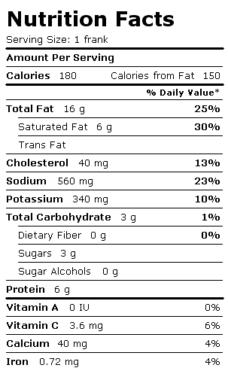
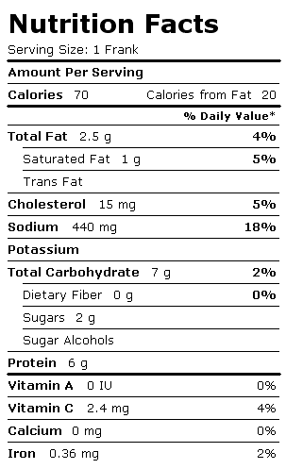
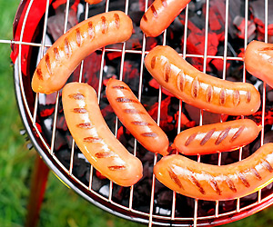
Cut the Fat and Calories
Hotdog #1
Hotdog #2

Slide 19
Eating Out
Use restraint at “all you can eat” buffets.
Limit restaurant eating to twice a week.
Split the meal with someone.
Take part of it home for another meal.
Ask for sauce, dressings, gravies on the side; use a small amount.
Choose wisely at salad bars.
Order less fried food.
Order water as your drink.

Slide 20
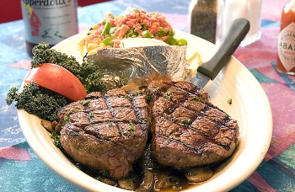
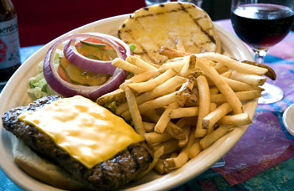
Beware of Portions!
Serving size:
3 ounce steak
8 ounce steak
12 ounce steak
16 ounce steak
Calories:
200-250
533-665
800-1,000
1,066-1,333
Remember, a calorie is a calorie no matter what the source. If you consume more calories than you need, you will gain weight.

Slide 21
Alcohol
May raise triglycerides.
Lots of calories, but no nutritional value.
Limit : 1-2 per day.
If you have diabetes: don’t drink alcohol on an empty stomach.
With some health conditions or medications, NO alcohol should be consumed -- ask your doctor.

Slide 22
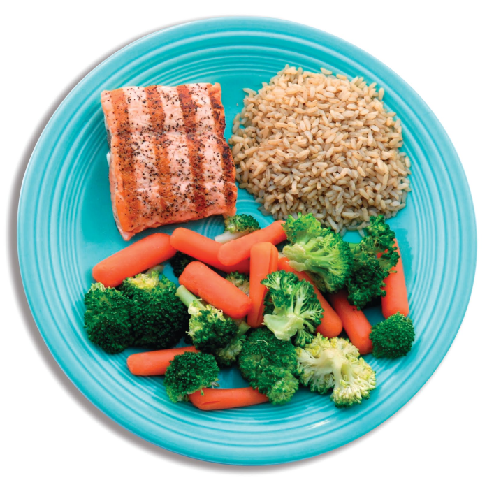
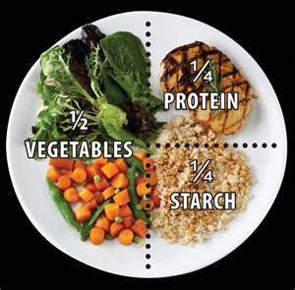
How does your plate stack up?

Slide 23

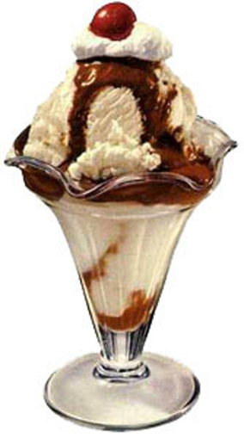
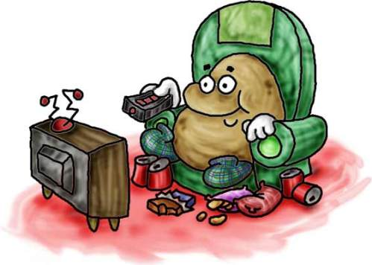

It takes 2 to TANGO…
It’s easy to blame food, but we ALL know that it’s really about FOOD & PHYSICAL ACTIVITY
The couch + a Coke = you croak!
Ice cream + Atari = you’ll be sorry!
You get the picture.

Slide 24
QUESTIONS?

